Slide 1


“Information Security”
Lecture # 3
Dr. Engr. M Malook Rind
Ph.D (I.T), ME (CSN), MBA (MIS), BE (CS)
CCNA, CCNP, Juniper Certified.
Professor (Computer Science)

Slide 2
Contents
Threats
Malwares
Vulnerabilities
Dr. M Malook Rind Information Security Lecture 3

Slide 3
Threats
Dr. M Malook Rind Information Security Lecture 3

Slide 4

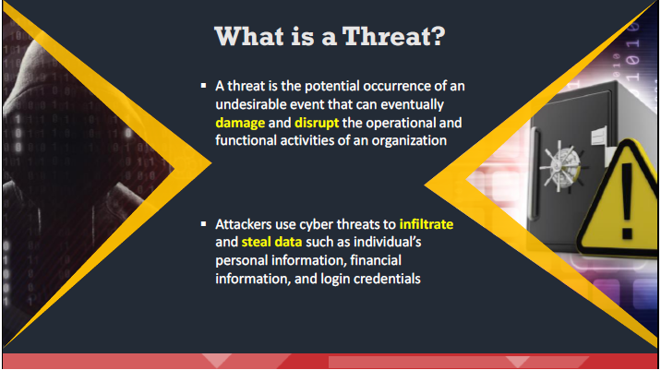
Threat
Threat is a possible security violation that might exploit the vulnerability of a system or asset. The origin of the threat may be accidental, environmental (natural disaster), human negligence, or human failure.
Dr. M Malook Rind Information Security Lecture 3

Slide 5
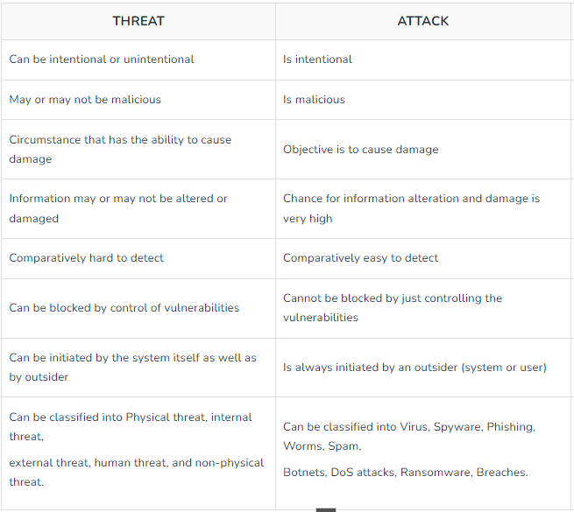
Difference between Threat and Attack
Dr. M Malook Rind Information Security Lecture 3

Slide 6
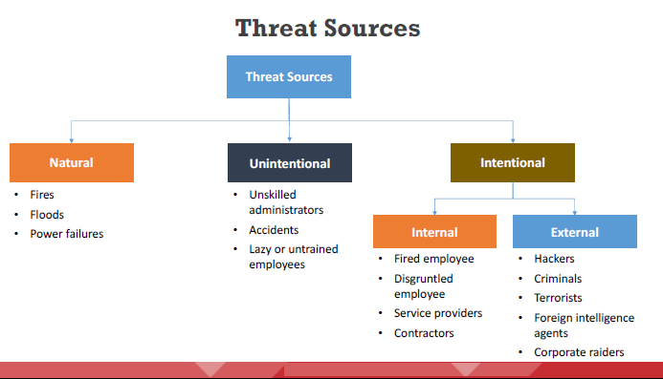
Threat Sources
The following are the various sources from which threats originate. They can be broadly classified as:
Dr. M Malook Rind Information Security Lecture 3

Slide 7
Threat Sources
Natural Threats
Natural factors such as fires, floods, power failures, lightning, meteor, and earthquakes are potential threats to the assets of an organization.
For example, these may cause severe physical damage to computer systems.
Unintentional Threats
Unintentional threats are threats that exist due to the potential for unintentional errors occurring within the organization.
Examples include insider-originating security breaches, negligence, operator errors, unskilled administrators, lazy or untrained employees, and accidents.
Intentional Threats
There are two sources of intentional threats.
Internal Threats: Most computer and Internet-related crimes are insiders or internal attacks. Insider attacks are more dangerous than external attacks because insiders are familiar with the network architecture, security policies, and regulations of the organization.
External Threats: by exploiting vulnerabilities that already exist in a network, without the assistance of insider employees.
Structured external threats: by technically skilled attackers, using tools to gain access into a network, for disrupting services.
Unstructured external threats: by unskilled attackers, typically script kiddies who may be aspiring hackers.
Dr. M Malook Rind Information Security Lecture 3

Slide 8
Malware
Dr. M Malook Rind Information Security Lecture 3

Slide 9
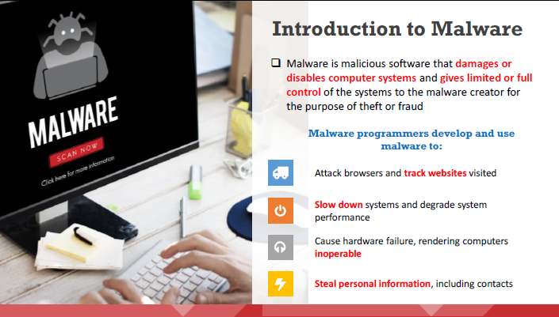
Malware and its Types
Dr. M Malook Rind Information Security Lecture 3

Slide 10
Introduction to Malware
Malware includes viruses, worms, Trojans, rootkits, backdoors, botnets, ransomware, spyware, adware, scareware, crapware, roughware, crypters, keyloggers, etc. This malicious software may delete files, slow down computers, steal personal information, send spam, or commit fraud.
Malware programmers develop and use malware to:
Attack browsers and track websites visited
Slow down systems and degrade system performance
Cause hardware failure, rendering computers inoperable
Steal personal information, including contacts
Erase valuable information, resulting in substantial data loss
Attack additional computer systems directly from a compromised system
Spam inboxes with advertising emails
Dr. M Malook Rind Information Security Lecture 3

Slide 11
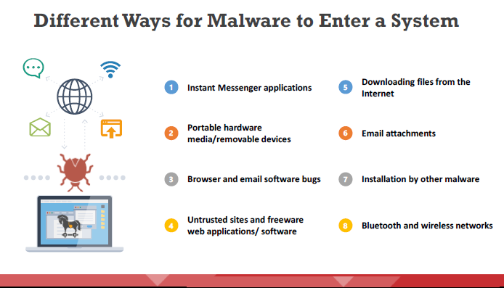
Introduction to Malware
Dr. M Malook Rind Information Security Lecture 3

Slide 12
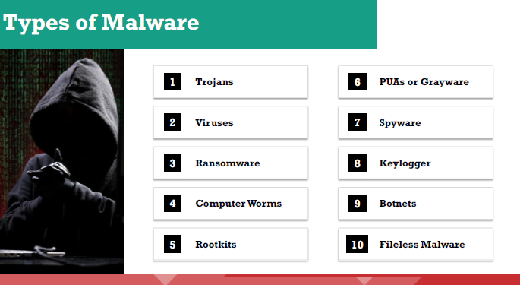
Introduction to Malware
A malware is a piece of malicious software that is designed to perform activities as intended by the attacker, without user consent.
Dr. M Malook Rind Information Security Lecture 3

Slide 13
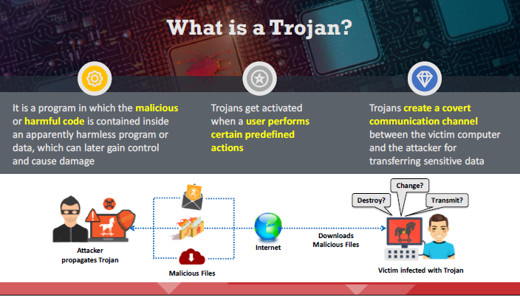
Types of Malware - Trojans
A Trojan is wrapped within or attached to a legitimate program, meaning that the program may have functionality that is not apparent to the user.
Dr. M Malook Rind Information Security Lecture 3

Slide 14
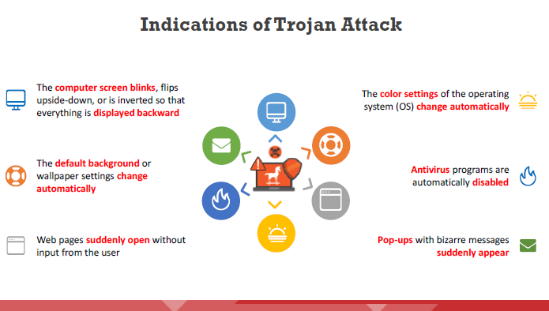
Types of Malware - Trojans
The DVD-ROM drawer opens and closes automatically.
Printers automatically start printing documents.
The sound volume suddenly fluctuates.
The date and time of the computer change.
The mouse cursor moves by itself.
The left- and right-click functions of the mouse are interchanged.
The mouse pointer disappears completely.
The mouse pointer automatically clicks on icons and is uncontrollable.
The Windows Start button disappears.
Dr. M Malook Rind Information Security Lecture 3

Slide 15
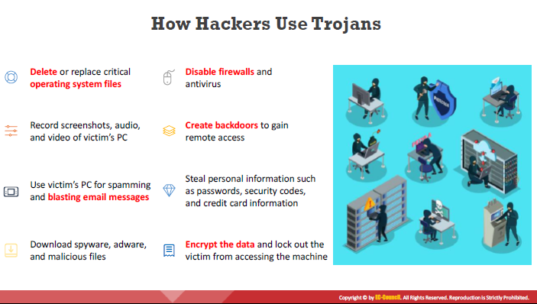
Types of Malware - Trojans
Dr. M Malook Rind Information Security Lecture 3

Slide 16
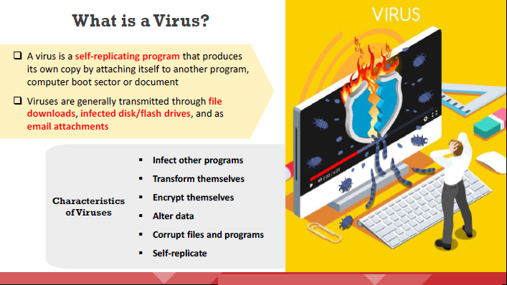
Types of Malware - Viruses
Some viruses affect computers as soon as their code is executed; other viruses remain dormant until a pre-determined logical circumstance is met. Viruses infect a variety of files, such as overlay files (.OVL) and executable files (.EXE, .SYS, .COM, or .BAT).
Dr. M Malook Rind Information Security Lecture 3

Slide 17
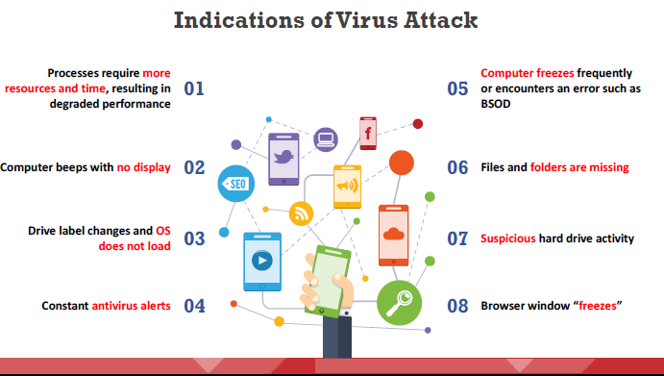
Types of Malware - Viruses
When a virus infects a computer, the victim or user will be able to identify some indications of the presence of virus infection.
Dr. M Malook Rind Information Security Lecture 3

Slide 18
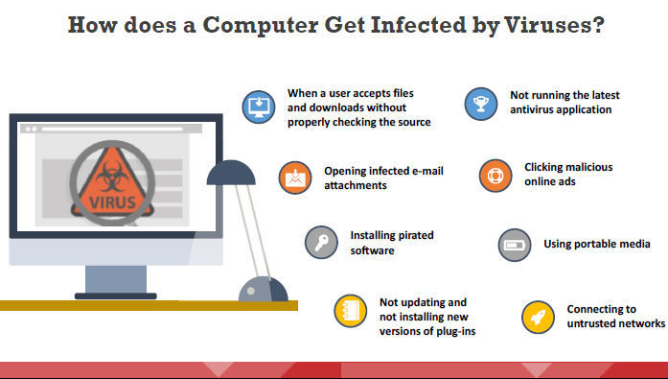
Types of Malware - Viruses
To infect a system, first, a virus has to enter it. Once the user downloads and installs the virus from any source and in any form, it replicates itself to other programs.
Dr. M Malook Rind Information Security Lecture 3

Slide 19
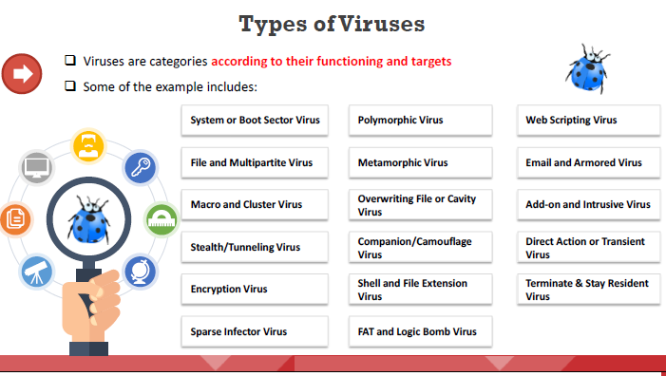
Types of Malware - Viruses
Attackers create viruses with disreputable motives. Criminals create viruses to destroy a company’s data, as an act of vandalism, or to destroy a company’s products.
Dr. M Malook Rind Information Security Lecture 3

Slide 20
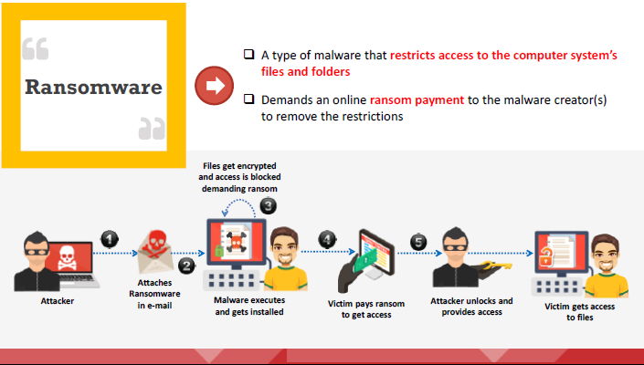
Types of Malware - Ransomware
Ransomware is a malware that lock the system and display messages meant to trick the user into paying the ransom.
Dr. M Malook Rind Information Security Lecture 3

Slide 21
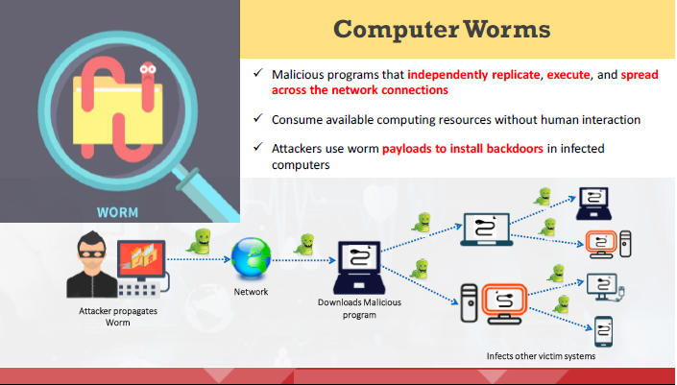
Types of Malware - Computer Worms
Dr. M Malook Rind Information Security Lecture 3

Slide 22
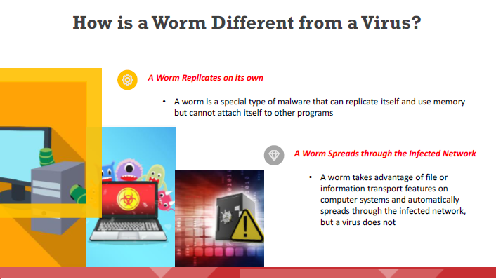
Types of Malware - Computer Worms
Dr. M Malook Rind Information Security Lecture 3

Slide 23
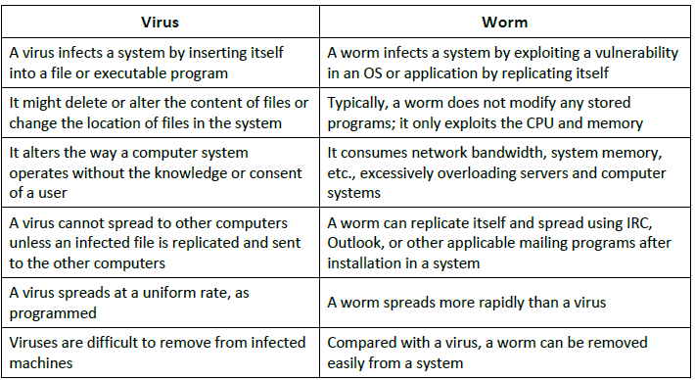
Types of Malware - Computer Worms
Dr. M Malook Rind Information Security Lecture 3

Slide 24
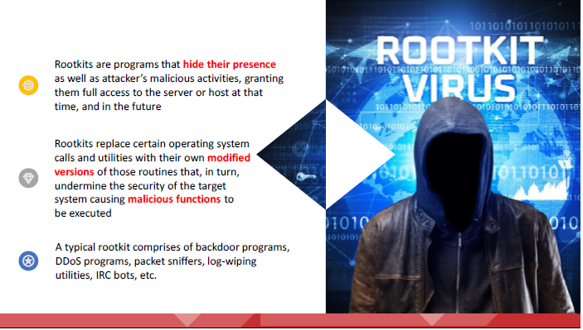
Types of Malware - Rootkits
Dr. M Malook Rind Information Security Lecture 3

Slide 25
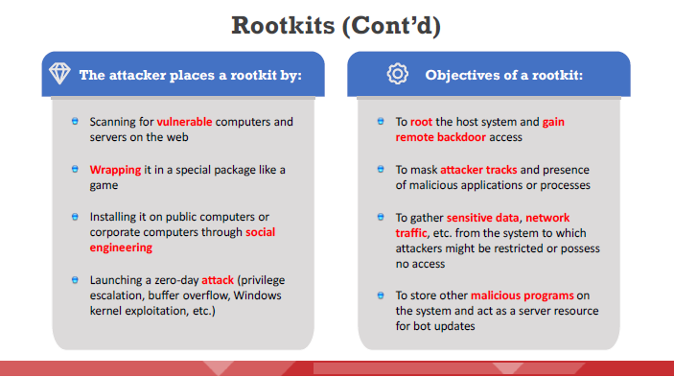
Types of Malware - Rootkits
Dr. M Malook Rind Information Security Lecture 3

Slide 26
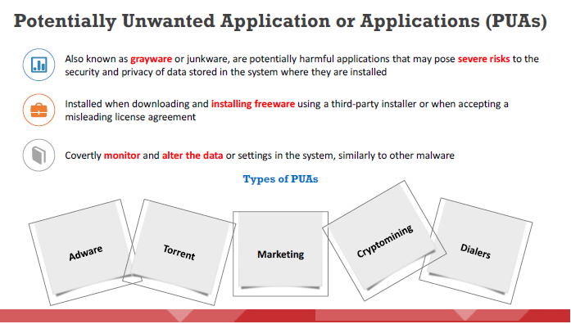
Types of Malware - Potentially Unwanted Application or Applications (PUAs)
A category of software that can cause your machine to run slowly, display unexpected ads, or at worst, install other software which may be more harmful or annoying.
Dr. M Malook Rind Information Security Lecture 3

Slide 27
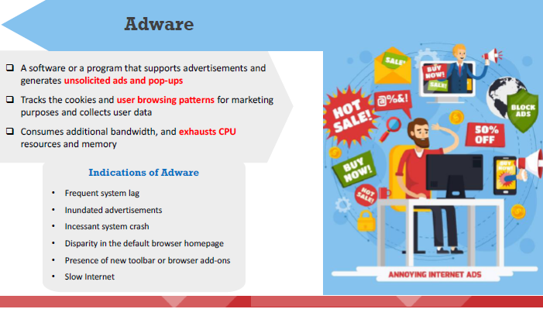
Types of Malware - Adware
Dr. M Malook Rind Information Security Lecture 3

Slide 28
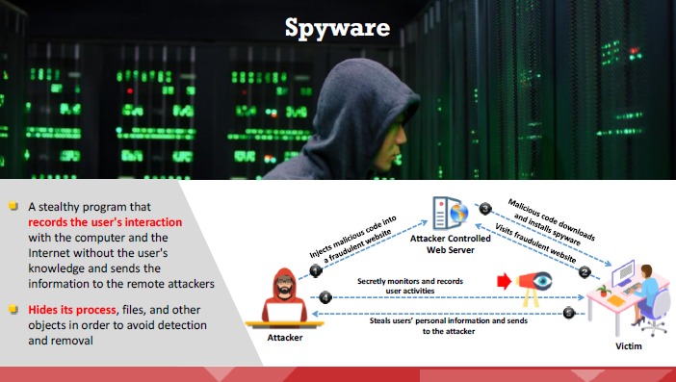
Types of Malware - Spyware
Dr. M Malook Rind Information Security Lecture 3

Slide 29
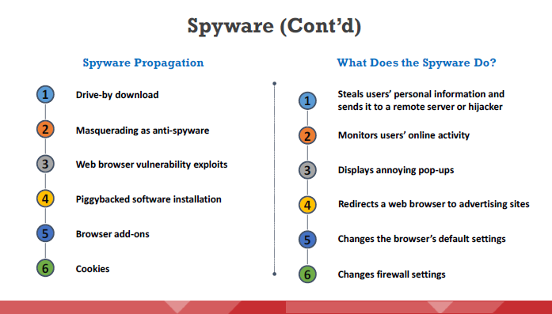
Types of Malware - Spyware
Dr. M Malook Rind Information Security Lecture 3

Slide 30
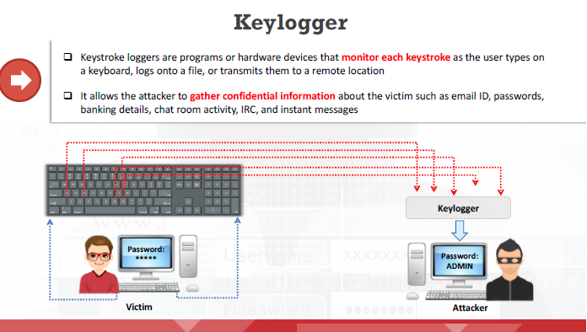
Types of Malware - Keylogger
Dr. M Malook Rind Information Security Lecture 3

Slide 31
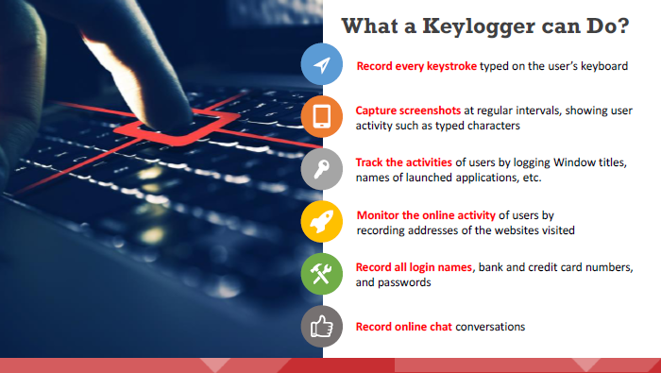
Types of Malware - Keylogger
Dr. M Malook Rind Information Security Lecture 3

Slide 32
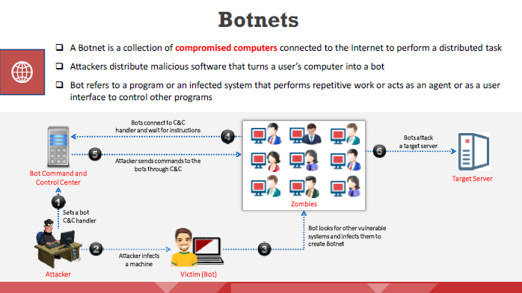
Types of Malware - Botnets
Dr. M Malook Rind Information Security Lecture 3

Slide 33
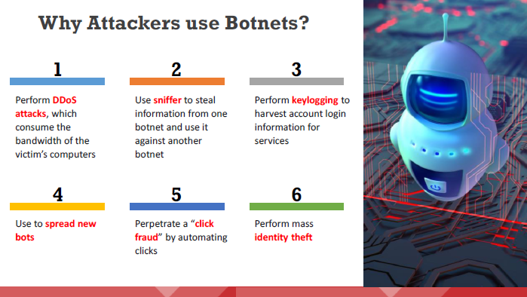
Types of Malware - Botnets
Dr. M Malook Rind Information Security Lecture 3

Slide 34
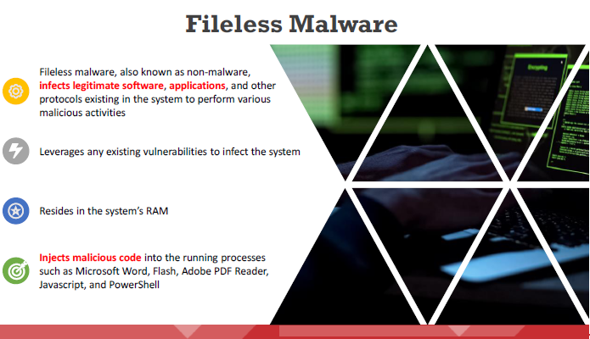
Types of Malware - Fileless Malware
Dr. M Malook Rind Information Security Lecture 3

Slide 35
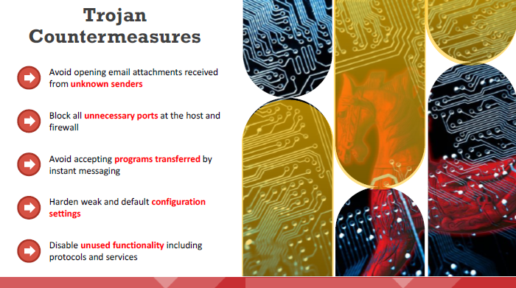
Types of Malware – Trojan Countermeasures
Dr. M Malook Rind Information Security Lecture 3

Slide 36
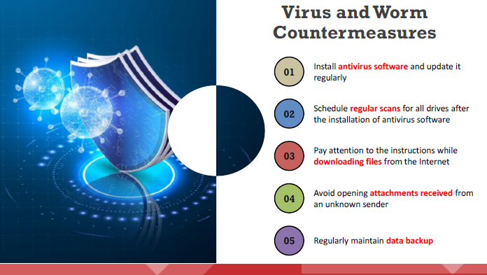
Types of Malware - Virus and Worm Countermeasures
Dr. M Malook Rind Information Security Lecture 3

Slide 37
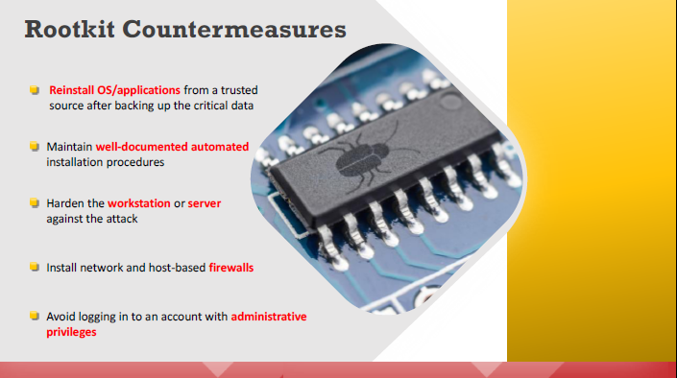
Types of Malware - Rootkit Countermeasures
Dr. M Malook Rind Information Security Lecture 3

Slide 38
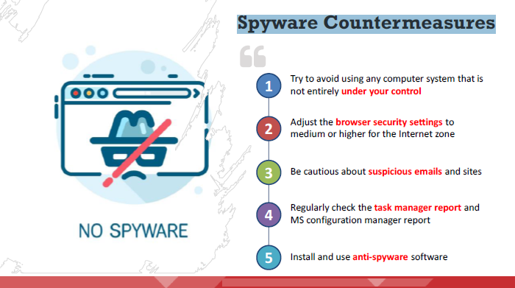
Types of Malware - Spyware Countermeasures
Dr. M Malook Rind Information Security Lecture 3

Slide 39
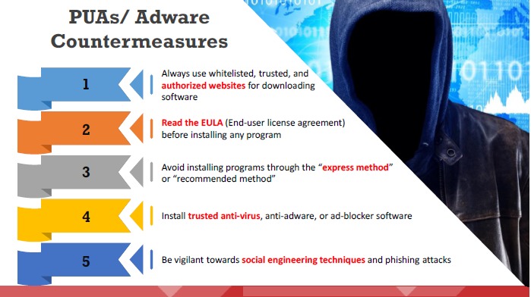
Types of Malware - PUAs/ Adware/Countermeasures
Dr. M Malook Rind Information Security Lecture 3

Slide 40
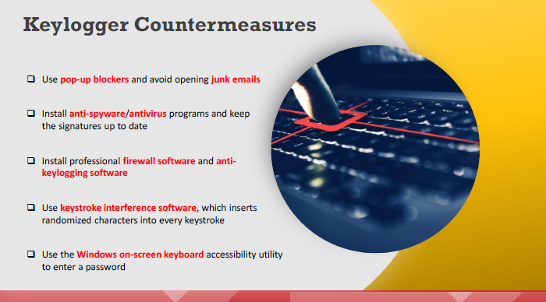
Types of Malware - Keylogger Countermeasures
Dr. M Malook Rind Information Security Lecture 3

Slide 41
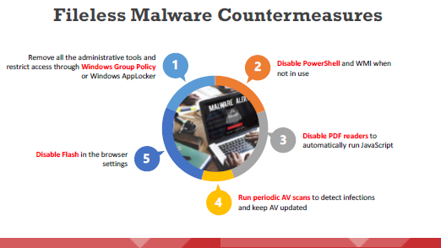
Types of Malware - Keylogger Countermeasures
Dr. M Malook Rind Information Security Lecture 3

Slide 42
Vulnerabilities
Dr. M Malook Rind Information Security Lecture 3

Slide 43
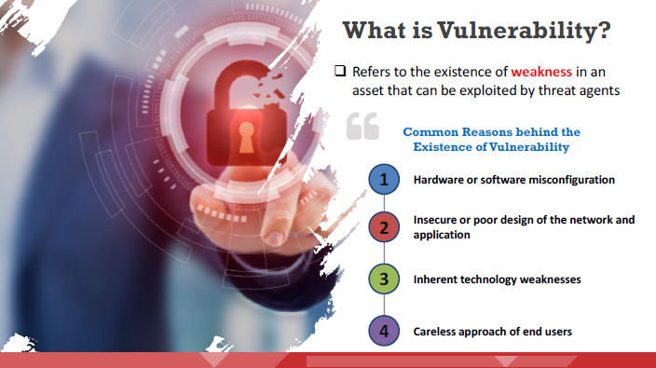
Define Vulnerabilities
Attackers
Dr. M Malook Rind Information Security Lecture 3

Slide 44
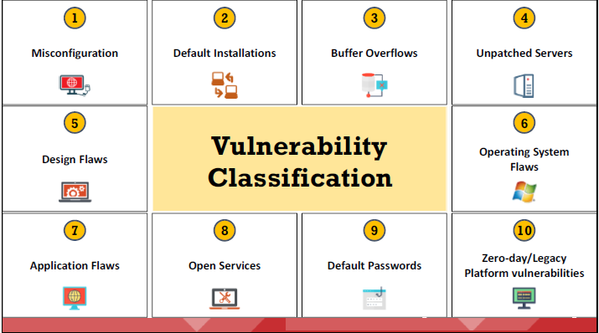
Vulnerability Classification
Vulnerabilities present in a system or network are classified into the following categories:
Dr. M Malook Rind Information Security Lecture 3

Slide 45
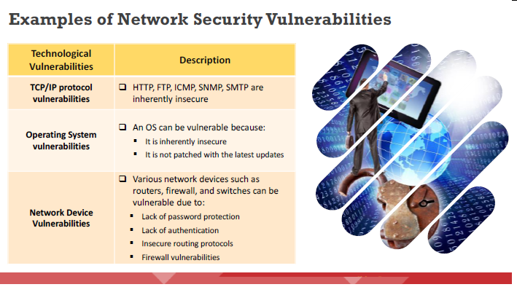
Vulnerability Classification
Examples of technological, configuration, and security policy vulnerabilities
Dr. M Malook Rind Information Security Lecture 3

Slide 46
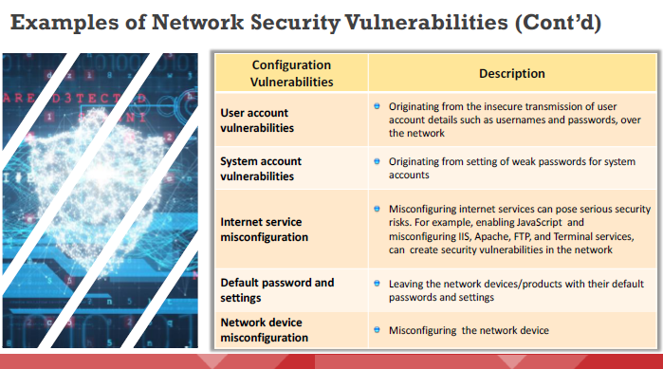
Vulnerability Classification
Dr. M Malook Rind Information Security Lecture 3

Slide 47
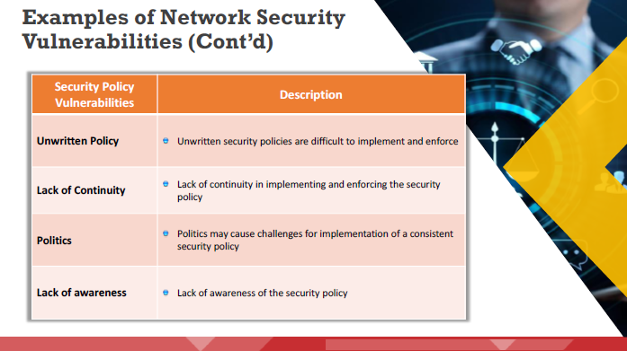
Vulnerability Classification
Dr. M Malook Rind Information Security Lecture 3

Slide 48
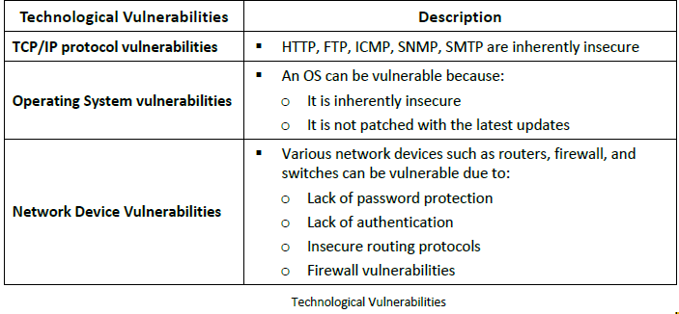
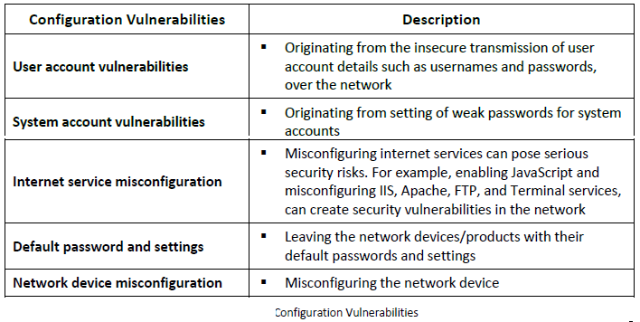
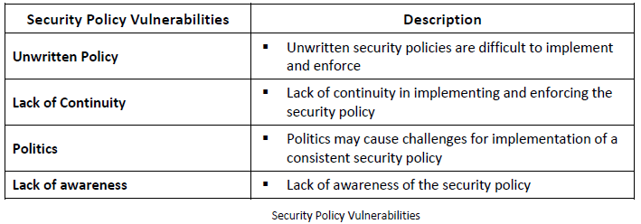
Vulnerability Classification
Dr. M Malook Rind Information Security Lecture 3

Slide 49
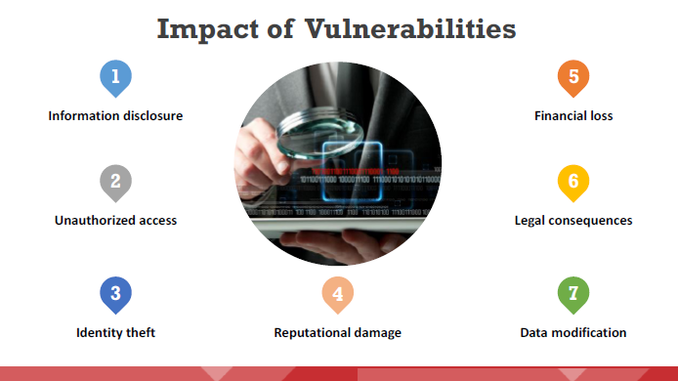
Impact of Vulnerabilities
Some of the impacts of vulnerabilities in networks and systems include
Dr. M Malook Rind Information Security Lecture 3

Slide 50
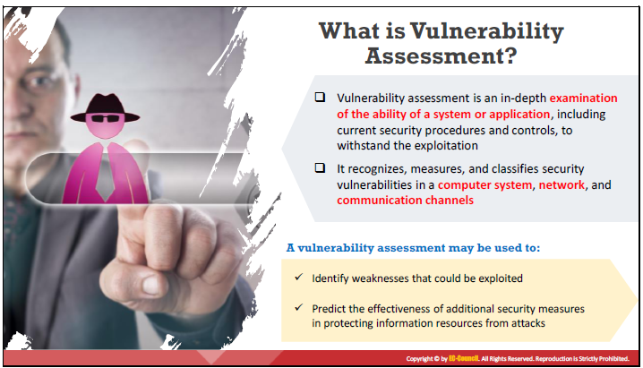
Vulnerability Assessment
A vulnerability assessment is an in-depth examination of the ability of a system or application, including current security procedures and controls, to withstand exploitation.
Dr. M Malook Rind Information Security Lecture 3

Slide 51
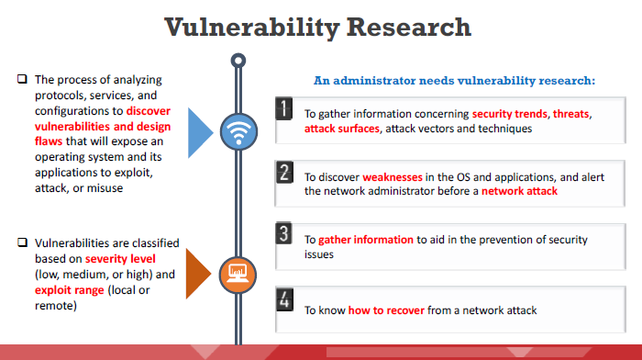
Vulnerability Assessment
Vulnerability assessment plays a major role in providing security to any organization’s resources and infrastructure from various internal and external threats.
Dr. M Malook Rind Information Security Lecture 3

Slide 52
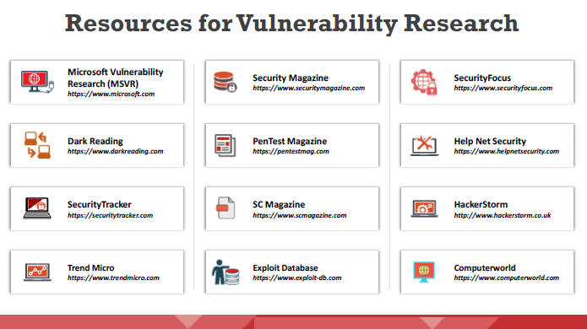
Vulnerability Assessment
The following are some of the online resources/websites used to perform vulnerability research:
Dr. M Malook Rind Information Security Lecture 3

Slide 53
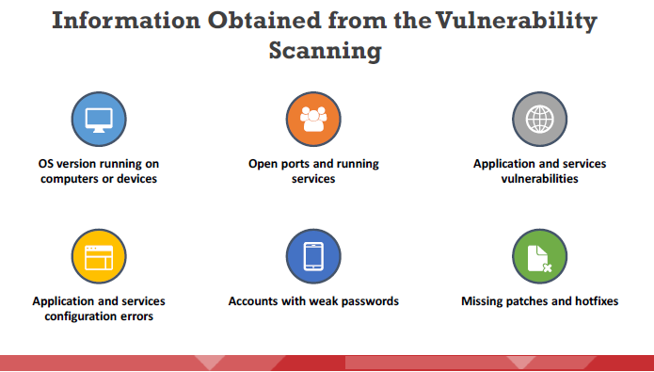
Vulnerability Assessment
Vulnerability scanners are capable of identifying the following information:
Dr. M Malook Rind Information Security Lecture 3

Slide 54
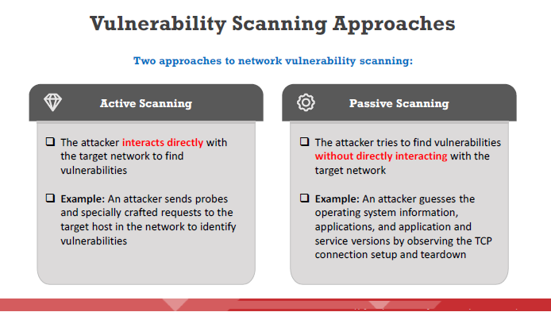
Vulnerability Assessment
Dr. M Malook Rind Information Security Lecture 3

Slide 55
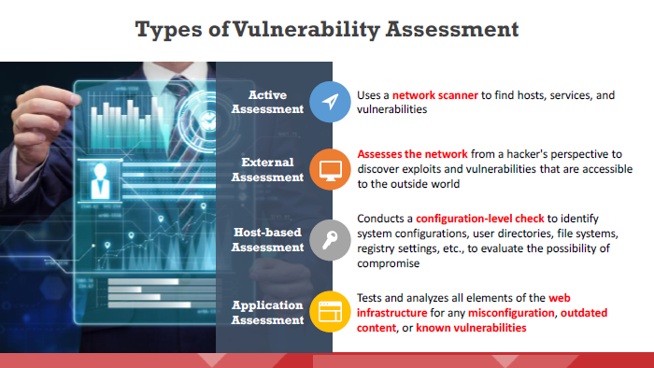
Vulnerability Assessment
Different types of vulnerability assessments
Dr. M Malook Rind Information Security Lecture 3

Slide 56

Vulnerability Assessment
Dr. M Malook Rind Information Security Lecture 3

Slide 57

Vulnerability Assessment
Dr. M Malook Rind Information Security Lecture 3

Slide 58

Vulnerability Assessment
The vulnerability management life cycle is an important process that helps identify and remediate security weaknesses before they can be exploited.
Dr. M Malook Rind Information Security Lecture 3

Slide 59

Vulnerability Assessment
An attacker performs vulnerability scanning to identify security loopholes in the target network that they can exploit to launch attacks. Security analysts can use vulnerability assessment tools to identify weaknesses present in the organization’s security posture and remediate the identified vulnerabilities before an attacker exploits them.
Dr. M Malook Rind Information Security Lecture 3

Slide 60

Vulnerability Assessment
Dr. M Malook Rind Information Security Lecture 3

Slide 61
Risk
Dr. M Malook Rind Information Security Lecture 3

Slide 62
Risk
Risk is the likelihood that a threat will exploit a vulnerability.
Information security risk comprises the impacts to an organization and its stakeholders that could occur due to the threats and vulnerabilities associated with the operation and use of information systems and the environments in which those systems operate
Risk mitigation reduces the chances that a threat will exploit a vulnerability or reduces the risk’s impact by implementing security controls
Dr. M Malook Rind Information Security Lecture 3

Slide 63
Thanks
Dr. M Malook Rind Information Security Lecture 3

